Slide 1
group memebers
Furtuna G/Slassie mit/ur/046/12
Betelhem Haftu mit/ur/159/12
Meles Mengesha mit/ur/ 298/12
Ayda Angesom mit/ur/ 158/12
Yorkabel Ngatu mit/ur/190/12
Meles H/Slassie mit/ur/101/12
Makda Haile mit/ur/231/12
Yemane G/Michael mit/ur/273/12
Michiale Adhanom mit/ur/166/12

Slide 2


Regression Report: Predicting Student Final Grades (G3)
This presentation details a regression project aimed at predicting the final grades of Portuguese secondary school students. Using the Student Performance Dataset, we apply a linear regression model to understand and anticipate outcomes based on demographic, social, and academic factors. This approach helps educators identify students who may need additional support early in the academic year.
We focus on the target variable G3 (final grade), exploring data characteristics, preprocessing techniques, model training, and evaluation results. Future work directives are provided to further improve predictive accuracy.
by Meles Haileselassie

Slide 3
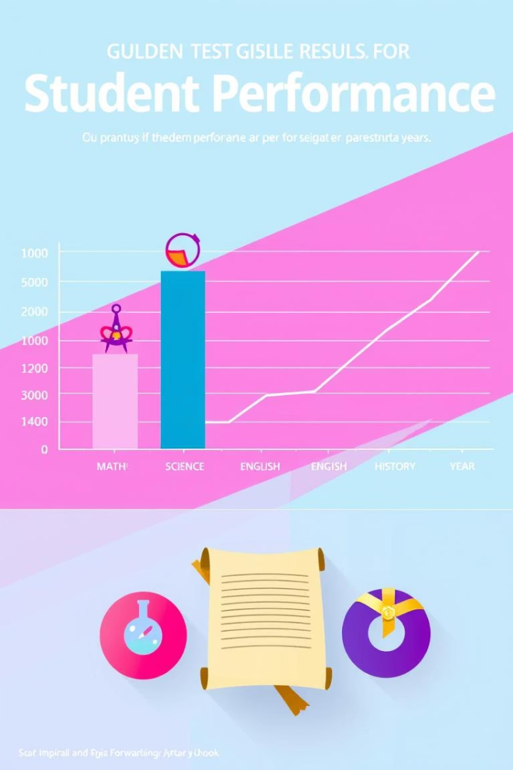
Introduction: Project Overview and Goals
Project Aim
Importance
Predict final grade (G3) using diverse student data including social and academic attributes.
Facilitates early identification of students at risk for poor outcomes to enhance intervention strategies.
Scope
Involves data from Portuguese secondary school students with multiple features influencing academic success.

Slide 4
Data Exploration and Characteristics
Dataset Details
Visual Insights
Source: UCI Machine Learning Repository
Histograms reveal distribution of numeric attributes
649 student records
Strong positive correlation among G1, G2, and G3 grades
32 features: categorical & numerical
Outliers noted in variables such as absences
No missing values detected

Slide 5

Methodology: Preprocessing and Data Splitting
Data Encoding & Scaling
Train-Test Split
OneHotEncoder applied to categorical variables, dropping the first to prevent multicollinearity; numerical features standardized using StandardScaler.
Dataset split into 80% training and 20% testing subsets, with a fixed random seed to ensure result reproducibility during evaluation.
Target Variable
The final grade (G3), a continuous numeric variable, is the prediction target for regression modeling.

Slide 6

Model Training: Linear Regression Application
Model Choice
Pipeline Integration
Baseline linear regression model implemented using scikit-learn for interpretability and simplicity.
Preprocessing steps and model training combined into a single pipeline to streamline the workflow and enhance reproducibility.
Hyperparameters
Default settings used for baseline; represents a starting point before tuning more complex parameters.

Slide 7
Results and Model Evaluation
Evaluation Metrics
Model Interpretation
RMSE: ~1.21
A strong R² score indicates ~81% variance explained. Average prediction errors of ~1.6 points are reasonable on a 0–20 grading scale.
MAE: ~0.77
R²: ~0.85
Residual analysis reveals mostly linear patterns with some underestimation for high-performing students, common for simple linear models.

Slide 8




Conclusion, Challenges, and Future Work
Summary of Findings
Model effectively captures linear relationships; previous term grades G1 and G2 are strong predictors of final performance.
Challenges
High number of categorical variables requires robust encoding, and some features contribute little, complicating the model.
Future Research
Explore nonlinear models like Random Forest and Gradient Boosting
Implement feature selection or dimensionality reduction techniques
Adopt cross-validation and hyperparameter tuning with GridSearchCV

